Slide 1
Host Partner Locker Wrapping Guidelines
Version
1.0
Release date 11/15/19
AMAZON CONFIDENTIAL - FOR INTERNAL DISTRIBUTION ONLY.

Slide 2
Host Partner Locker Wrapping Guidelines
Locker Wrapping
Key Points
Amazon Hub and hosting companies must maintain distinct,
individual brands.
To reduce confusion with Amazon Hub Apartment Locker and
other smart locker systems, it is important that we maintain
consistency on what can or cannot be wrapped on Lockers.
For this reason, Amazon Hub avoids mixing brand assets to
prevent customer confusion, aid in customer recognition, and
preserve brand equity.
AMAZON CONFIDENTIAL - FOR INTERNAL DISTRIBUTION ONLY.

Slide 3
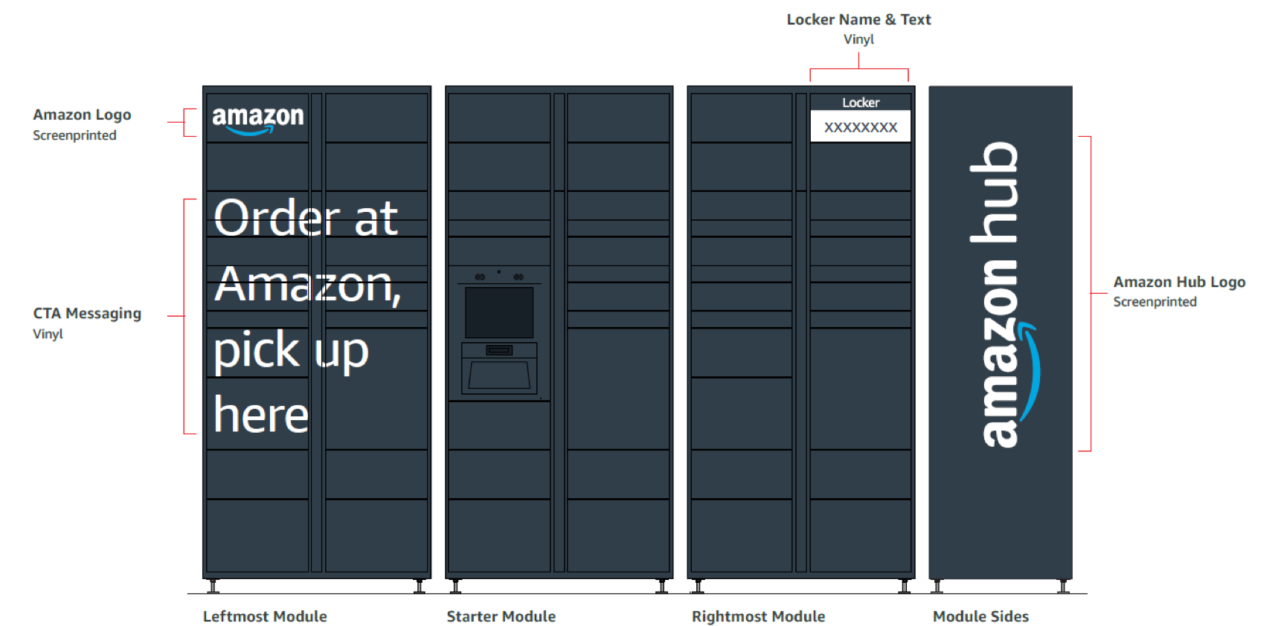
Host Partner Locker Wrapping Guidelines
Locker
AMAZON CONFIDENTIAL - FOR INTERNAL DISTRIBUTION ONLY.

Slide 4
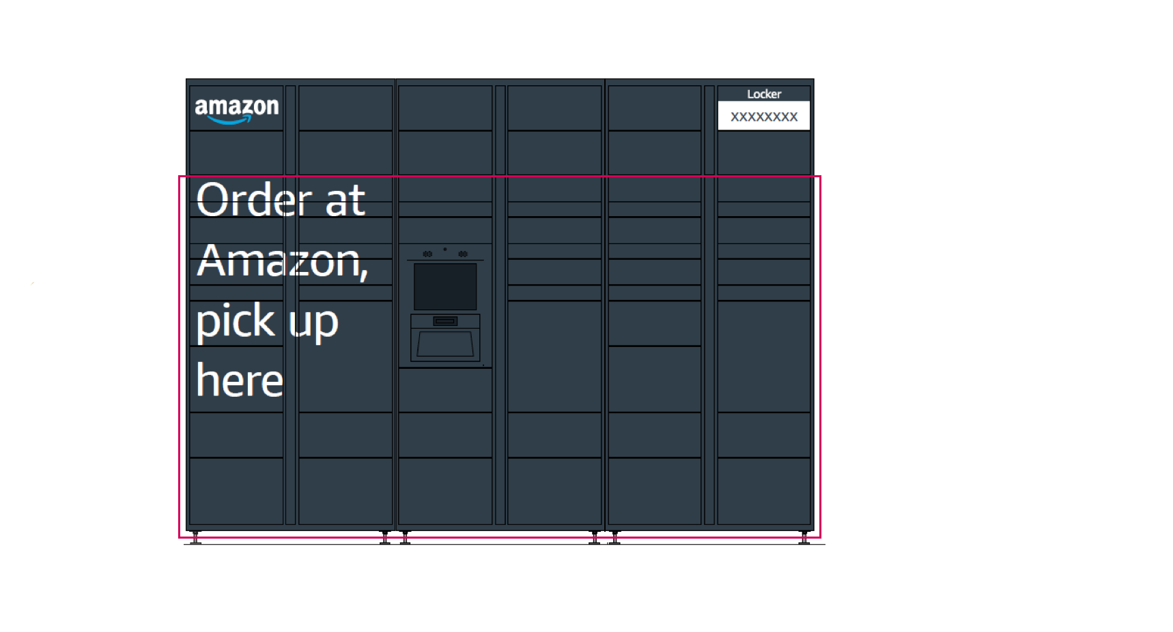
Host Partner Locker Wrapping Guidelines
North America – Squid Ink Kit
Wrap Design Area
AMAZON CONFIDENTIAL - FOR INTERNAL DISTRIBUTION ONLY.

Slide 5
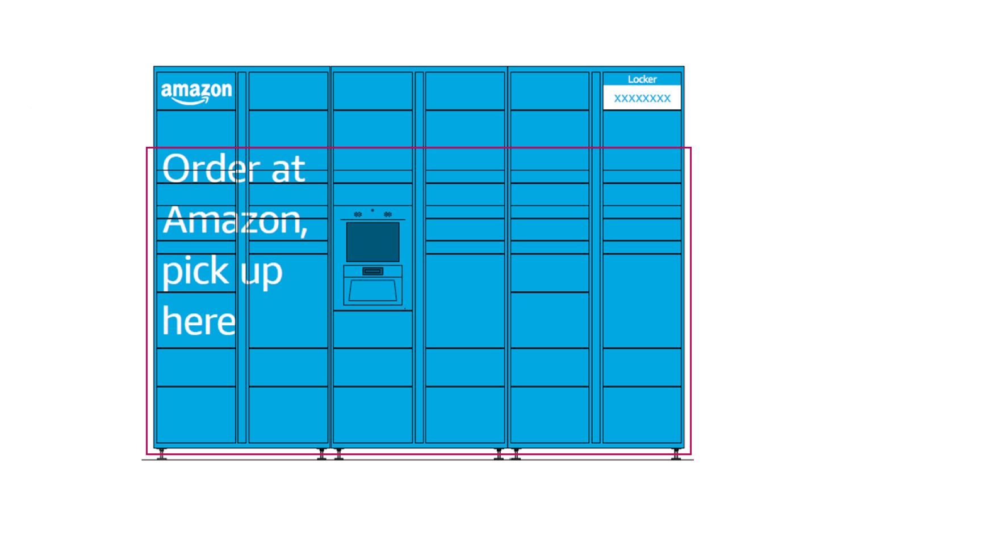
Host Partner Locker Wrapping Guidelines
North America – Prime Blue Kit
Wrap Design Area
AMAZON CONFIDENTIAL - FOR INTERNAL DISTRIBUTION ONLY.

Slide 6
Host Partner Locker Wrapping Guidelines
Amazon Hub Consistency Requirements
The following cannot be adjusted, wrapped over, or mix with other elements.
Amazon logo (Top left)
Locker name (Top Right)
Amazon Hub logo on module sides
First two horizontal rows
The following can be used as part of the wrap
“Order at Amazon, pick up here” is owned by Amazon Hub and must only be included if the typography is in Amazon Ember with brand approved colors.
The writing is strongly recommended as it adds to that consistency and creates a better user experience.
AMAZON CONFIDENTIAL - FOR INTERNAL DISTRIBUTION ONLY.

Slide 7
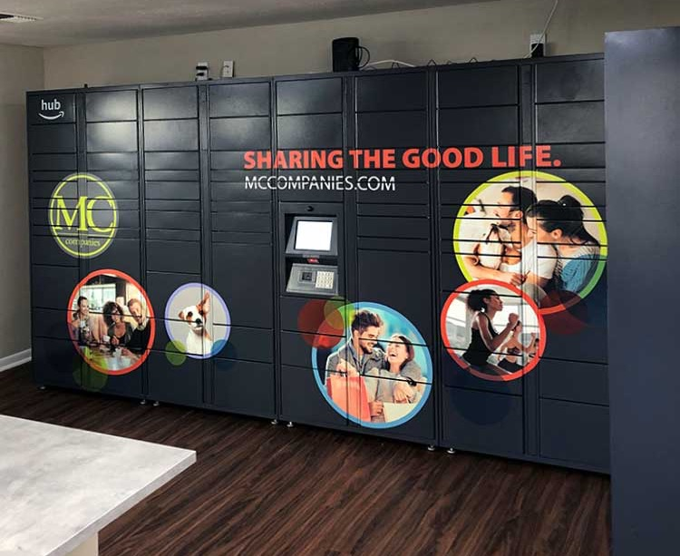
Host Partner Locker Wrapping Guidelines
Good Examples
AMAZON CONFIDENTIAL - FOR INTERNAL DISTRIBUTION ONLY.

Slide 8
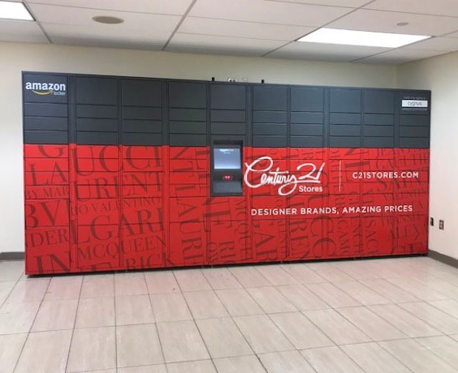
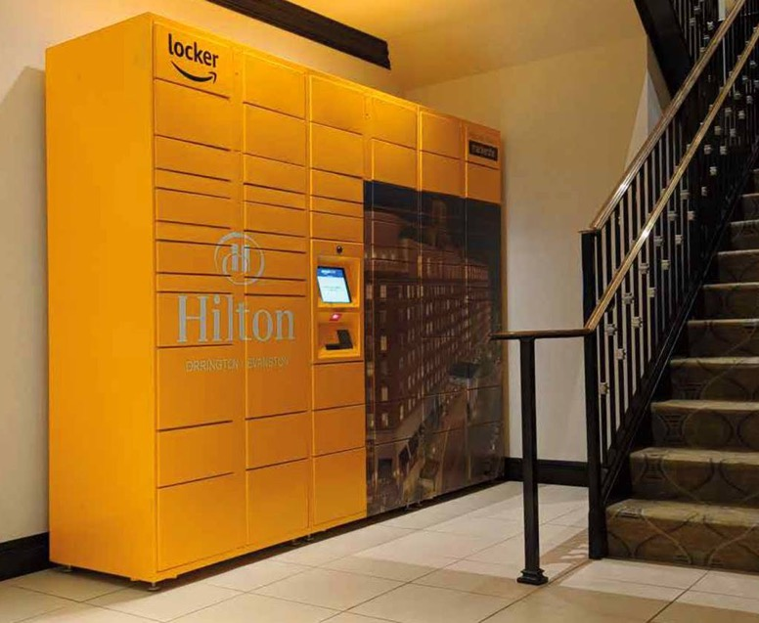
Host Partner Locker Wrapping Guidelines
Good Examples (Continued)
AMAZON CONFIDENTIAL - FOR INTERNAL DISTRIBUTION ONLY.

Slide 9
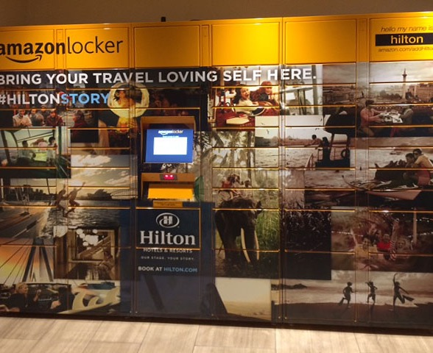
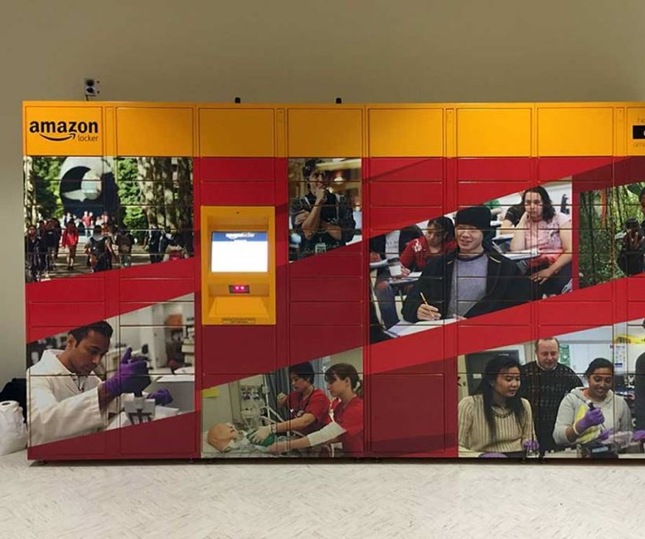
Host Partner Locker Wrapping Guidelines
Bad Examples (Continued)
AMAZON CONFIDENTIAL - FOR INTERNAL DISTRIBUTION ONLY.

Slide 10
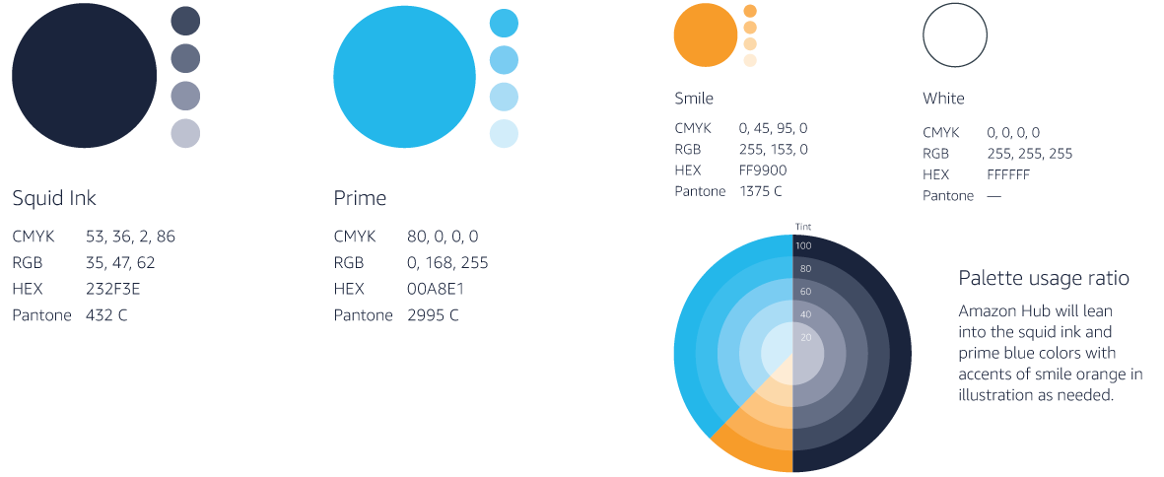
Host Partner Locker Wrapping Guidelines
Brand Colors
At its most basic, color is an identifying element that makes the brand feel more consistent and cohesive across multiple mediums and messages. At a deeper level, color is evocative. It creates emotion, attraction, and psychological, subconscious response. The Amazon Hub brand uses color as an identifying element to cultivate recognition and consistency across multiple mediums and messages.
AMAZON CONFIDENTIAL - FOR INTERNAL DISTRIBUTION ONLY.

Slide 11
Host Partner Locker Wrapping Guidelines
Preferred Service Providers
Wrapping Company
The Sandbox Group – John Hern – john@sbxgrp.com – 206.571-8632
Super Graphics – NA - 206.284.2201 - https://supergraphics.com/services/vinyl-graphics/wraps/lockers/amazon-locker-branding/
Designing Company
Brand ink – NA - 888.592.4317 – https://www.brandink.com/
Super Graphics – NA - 206.284.2201 - https://supergraphics.com/services/vinyl-graphics/wraps/lockers/amazon-locker-branding/
AMAZON CONFIDENTIAL - FOR INTERNAL DISTRIBUTION ONLY.

